Slide 1
MongoDB with NodeJS
MongoDB Driver for Node
Connection to MongoDB
CRUD Methods on a Collection
Utilizing asnc/await

Slide 2
Start Point
Start a MongoDB Server
Download and install the right MongoDB version
Create a new Node project (npm init)
Install the mongoDB driver dependency (npm install mongodb –save)
start a mongod process (mongod --dbpath=/data). In this case, the database directory is /data . Your process may already be running if it was installed as a service (Windows)

Slide 3
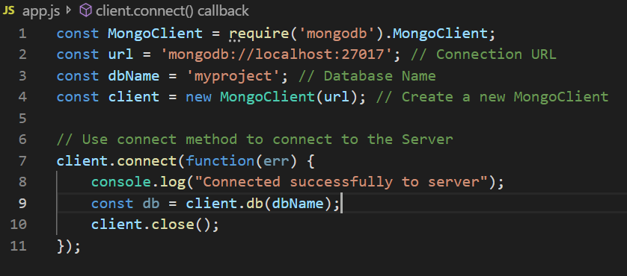
Connection to MongoDB
Create app.js as follows and "node app.js" command will print Connected successfully to server to the console. The "connect" method is asynchronous and a call back it used to respond to a connection (or failed connection)

Slide 4
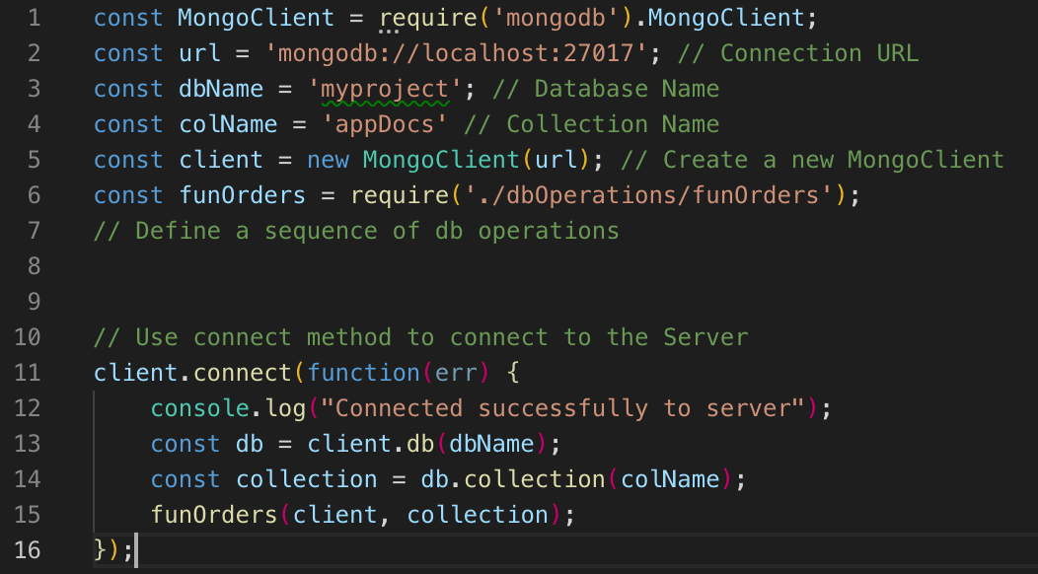
On Connection
On the connection to the mongoDB server, we can start or open an existing data base db by client.db(dbName) and a collection by db.connection(colName). We can put more db operations in module funOrders

Slide 5
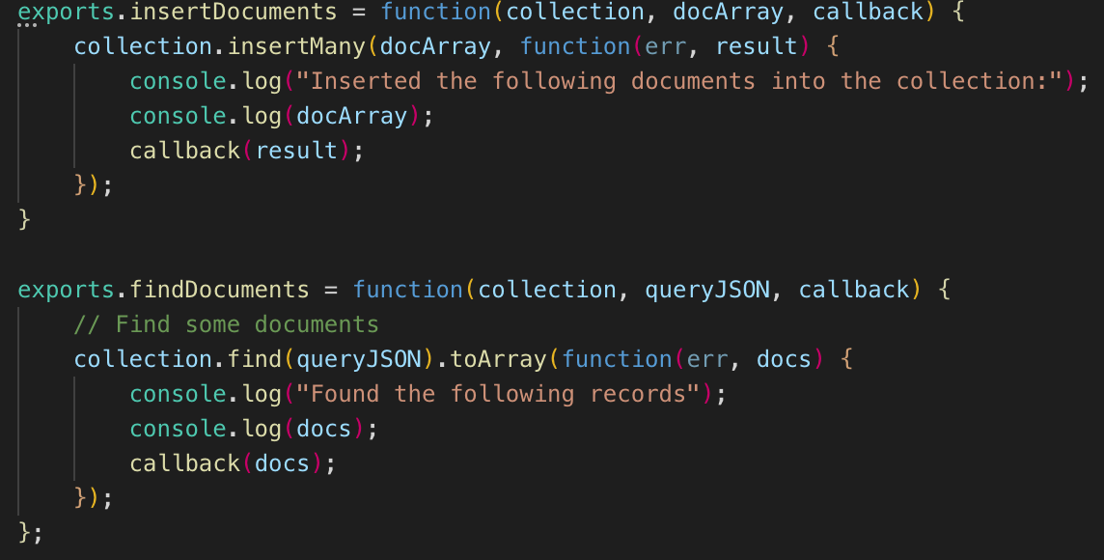
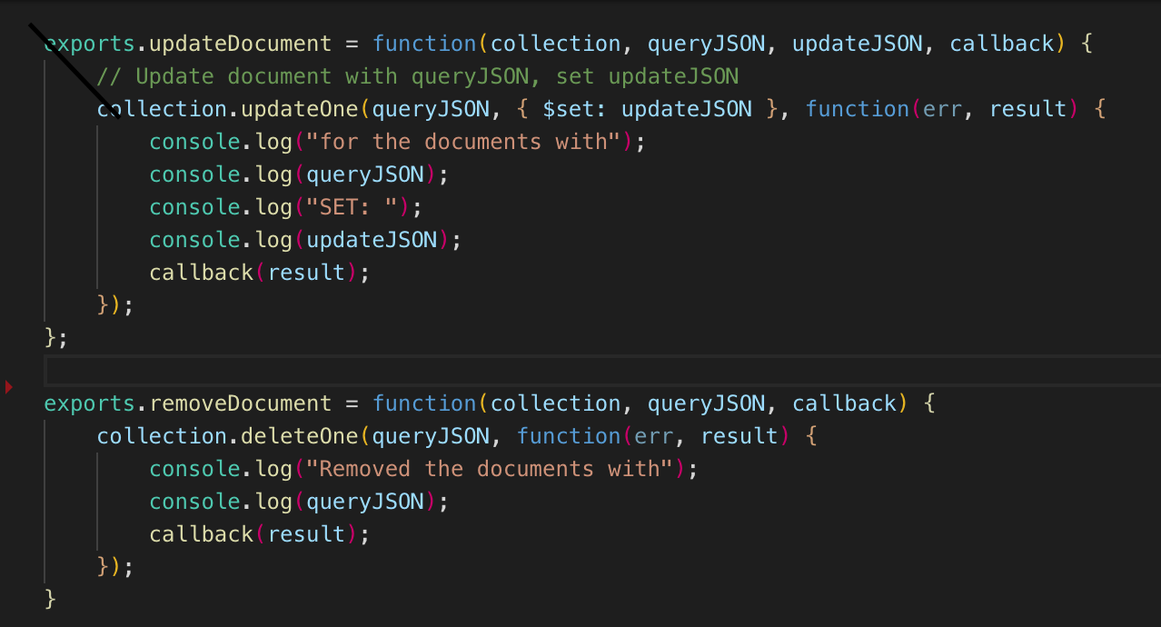
CRUD Methods on a Collection
We may create some methods as follows. We put a parameter callback in each method so that we can use callback as other method and execute two methods in sequence.

Slide 6
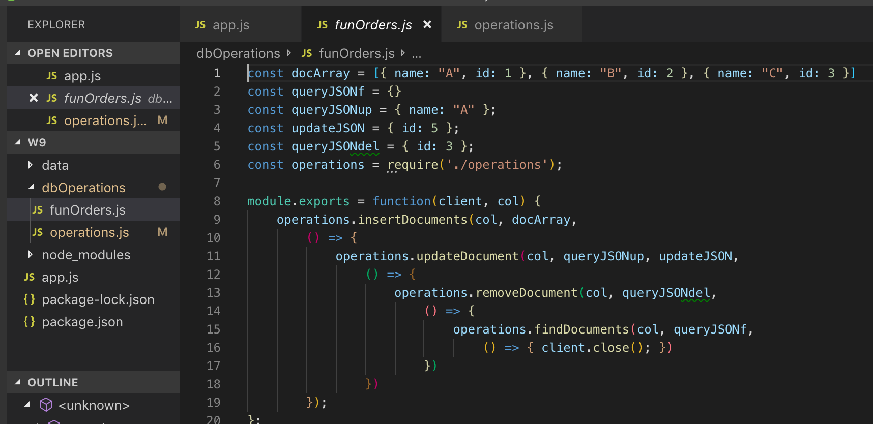
Sequence of CRUD Methods
The following module executes the fours methods in sequence
​

Slide 7
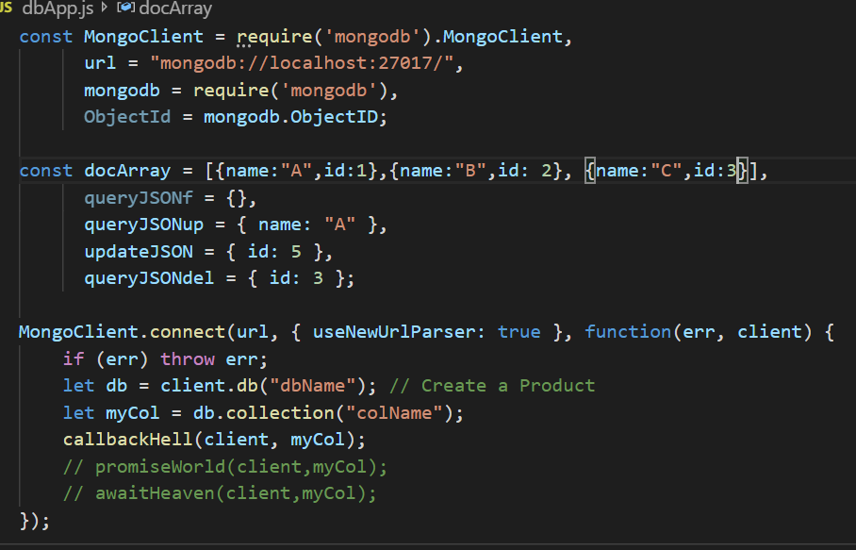
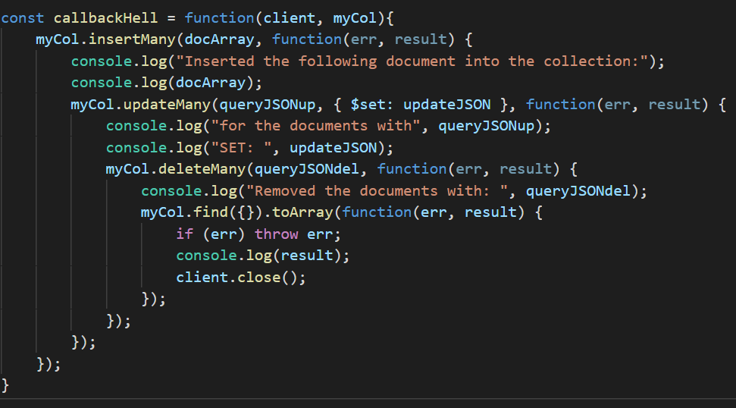
All-in-One version
We may get an all-in-one module to executes the fours methods.
However, the function callbackHell looks messy, involving nest of callback functions.
​

Slide 8
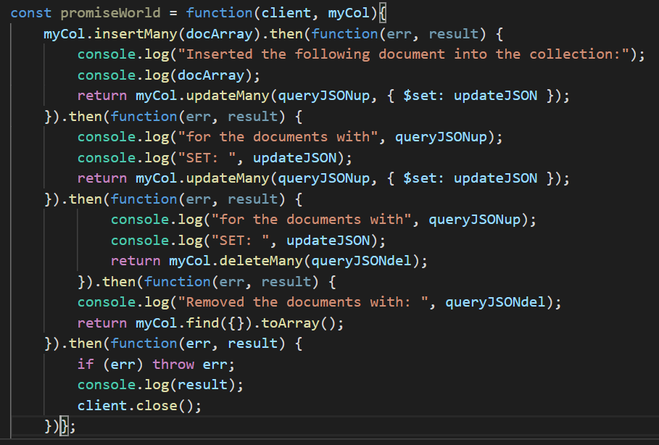
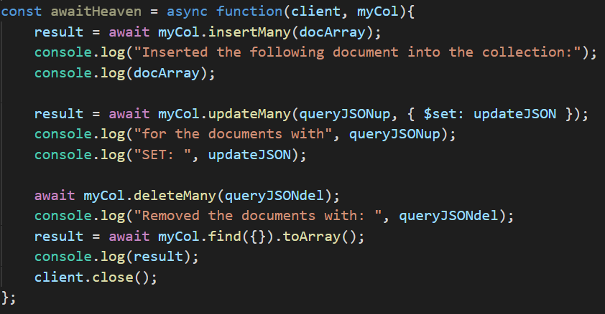
All-in-One by using Promise
Fortunately, Node mongoDB driver provides both callback and promise version for all-most all operations. We may use the following alternatives: promiseWorld or awaitHeaven to replace callbackHell. By utilizing asnc/await, awaitHeaven seems succinct and elegant.
​

Slide 9
MongoDB with Node
The following links show how to set up a simple application using Node.js and MongoDB, including setting up the driver and performing the simple CRUD operations.
https://www.w3schools.com/nodejs/nodejs_mongodb.asp
https://mongodb.github.io/node-mongodb-native/3.2/quick-start/quick-start/

